Slide 1
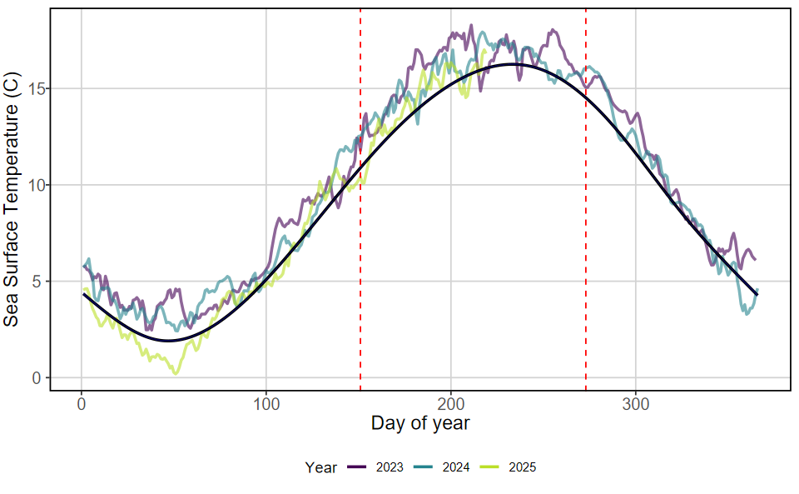
Environmental context
Notes:
Figure 1. Fluctuations in average daily Casco Bay surface temperature per year (colored lines) as compared to the expected daily average temperatures as calculated from the 2003-2020 Climate Reference Period. All data are from the Portland Harbor Tide Gauge, which is the closest consistent source of surface temperature data. Red dashed lines indicate the summer internship period, which coincides with many QBC conservation activities and CBASS sampling.

Slide 2
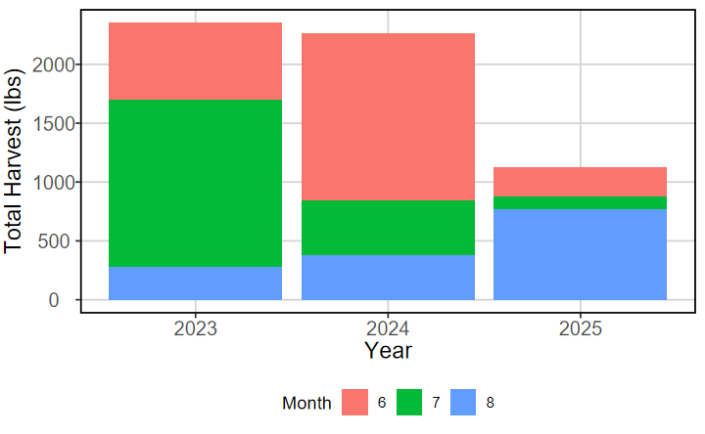
Crabbing
Notes:
Figure 2. Monthly total crab harvest per year.

Slide 3
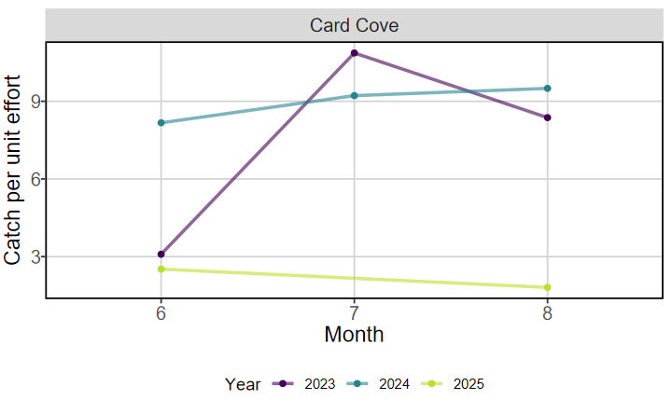
Crabbing
Notes:
Figure 3. Monthly green crab catch per unit effort (biomass caught per trap) over the 2023-2025 period. Data come from only Card Cove, which is the site with the most consistent sampling per year.

Slide 4
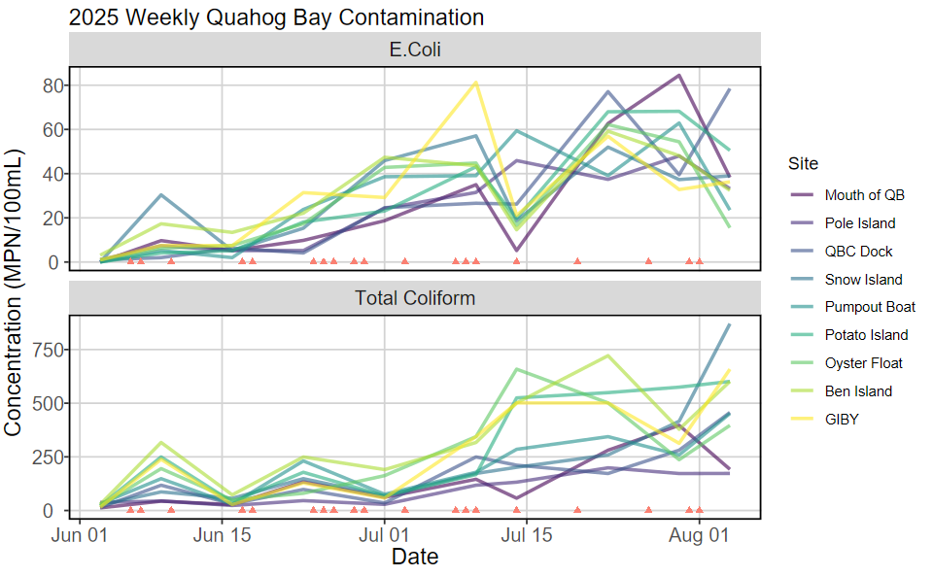
Water Quality
Notes:
Figure 4. Weekly E. Coli or Total Coliform concentration (Most Probable Number of cells per 100 mL) at each sampling site across the 2025 season. Color of line indicates site. Red triangles indicate days with measurable rainfall.

Slide 5
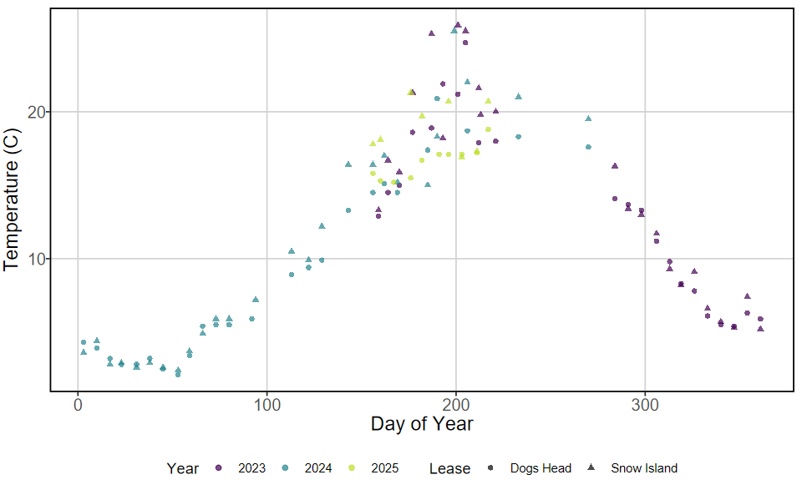
Oyster Condition Index
Notes:
Figure 5. Surface water temperature collected at the Dogs Head (circle) or Snow Island (triangle) aquaculture lease sites. Color of points indicates the year in which the sample was taken.

Slide 6
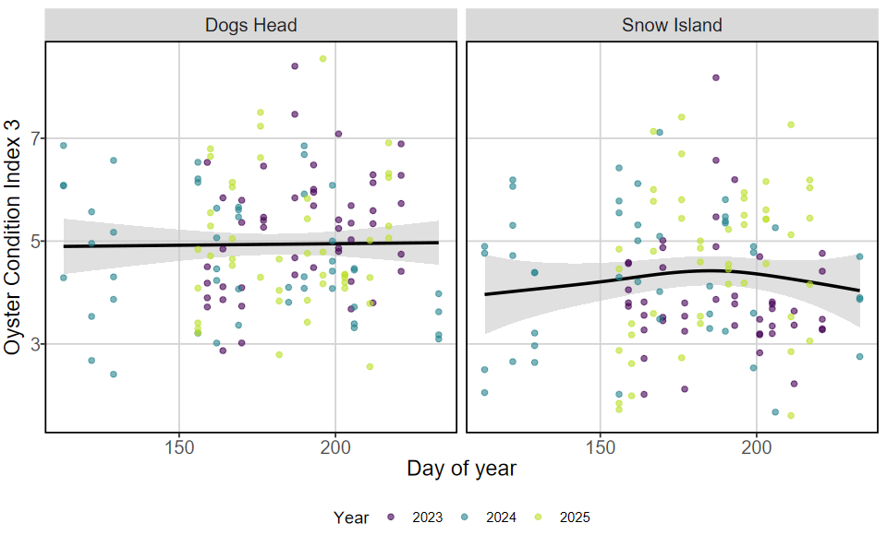
Oyster Condition Index
Notes:
Figure 5. Models of oyster condition index (100*dry meat weight / dry shell weight) separated by lease site. Color of points indicates year in which a sample was taken. Data were limited to include only samples taken from April to September, which encompasses the growing season.

Slide 7
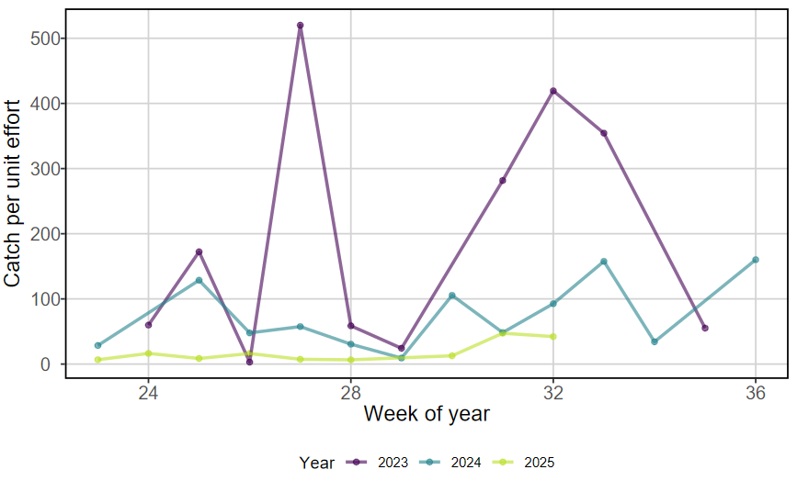
CBASS
Notes:
Figure 6. Weekly catch per unit effort (average number of fish caught per seine haul) for each year of QBC CBASS (Casco Bay Aquatic Systems Survey) data collection. Color indicates year.

Slide 8
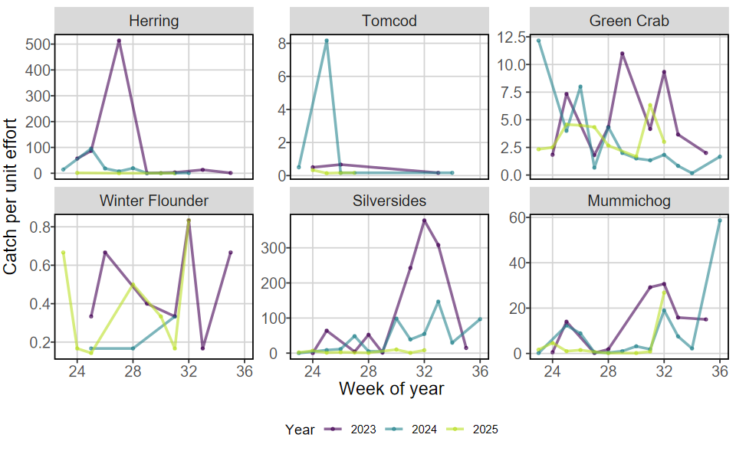
CBASS
Notes:
Figure 7. Weekly catch per unit effort (average number of individuals caught per seine haul) for cold-adapted (Herring, Tomcod), widely dispersed (green crab, winter flounder), and warm-adapted (silversides, mummichog) species commonly encountered in Casco Bay. Data come from the three years of QBC CBASS data collection, with color representing year in which the data were collected.

Slide 9
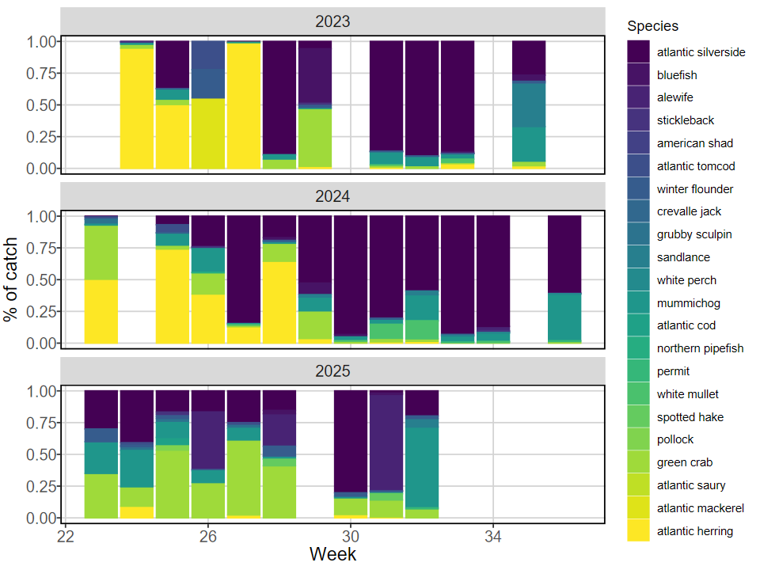
CBASS
Notes:
Figure 8. Proportion of weekly catch attributable to each species encountered in 2023-2025 QBC CBASS sampling. Color of bar indicates species.

Slide 10
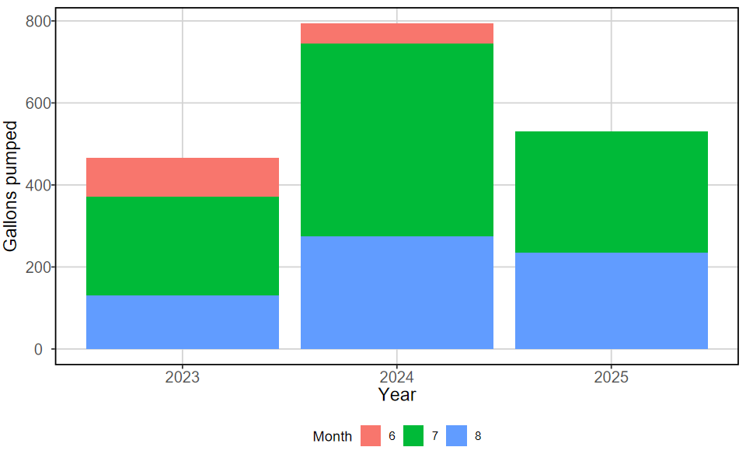
Pumpout
Notes:
Figure 9. Monthly total volume of waste collected by the pumpout boat for 2023 through 2025. Color of bar indicates month.

Slide 11
Marine Debris Removal
Include some pictures of you guys doing trash pickup

Slide 12
Plankton Culturing
Include some pictures of you guys doing plankton husbandry

